Slide 1




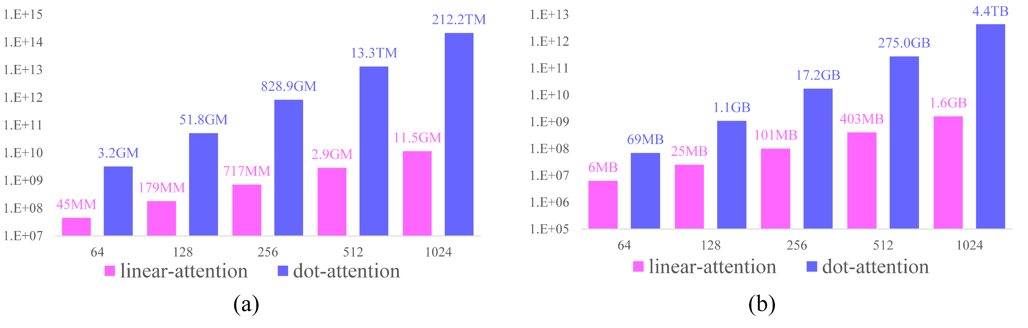
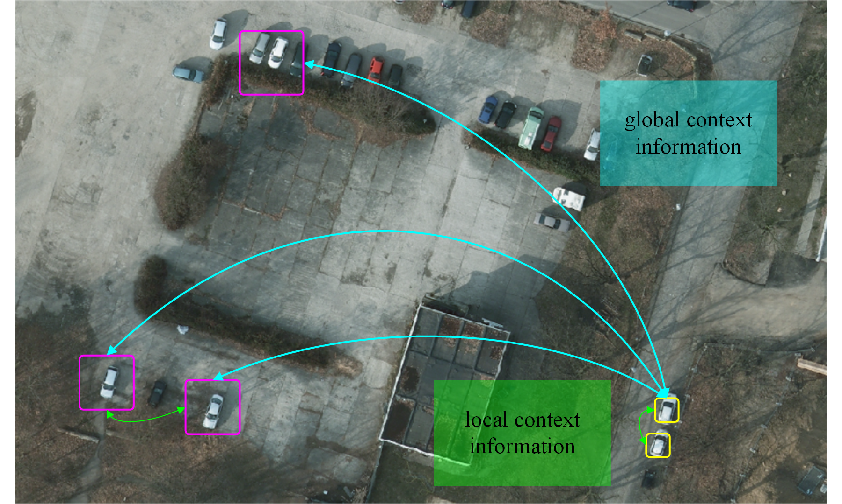



首届《遥感学报》青年学术论坛暨第六届全国遥感地理信息研究生论坛
Linear Attention meets Semantic Segmentation
李睿
武汉大学遥感信息工程学院
Introduction
Replace the softmax function by its Taylor expansion
$$e^{{q_{i}}^{T}∙k_{j}}≈1+{q_{i}}^{T}∙k_{j}$$
Linear attention mechanism
$$D\left(Q, K, V\right)=\frac{\sum_{j}{V_{i,j}}+\left(\frac{Q}{{\left\|Q\right\|}_{2}}\right)\left({\left(\frac{K}{{\left\|K\right\|}_{2}}\right)}^{T}V\right)}{N+\left(\frac{Q}{{\left\|Q\right\|}_{2}}\right)\sum_{j}{{\left(\frac{K}{{\left\|K\right\|}_{2}}\right)}_{i,j}^{T}}}$$
Context matters for semantic segmentation
Per-pixel classification is often ambiguous in the presence of only local information. But the task becomes much simpler if contextual information, from the whole image, is available
Attention is effective for context extraction
With strong capabilities to capture long-range dependencies, dot-product attention mechanisms have been applied in vision and NLP tasks
Capturing context information is consuming
Utilization of the dot-product attention mechanism often
comes with signiﬁcant memory and computational costs,
which increases quadratically with the size of the input over space and time
Results
Fig 2. Comparison between the (a) computational and (b) memory requirements of the linear attention mechanism and dot-product attention mechanism.
Fig 3. The mIoU of different methods on the UAVid dataset..
Conclusion
Fig. 1. Illustration of global and local contextual information.
The proposed linear attention mechanism is an effective and efficient method which balances the global context and resource consumption well. Based on the linear attention mechanism, the proposed ABCNet achieves a comparative result on UAVid dataset.
Methodology
Dot-product attention mechanism
$$D\left(Q, K, V\right)=ρ\left(QK^{T}\right)V.$$
where
$$\left\{\begin{aligned}Q={XW}_{q}∈ℝ^{N{×D}_{k}}; \\ K={XW}_{k}∈ℝ^{N×D_{k}}; \\ V={XW}_{v}∈ℝ^{N×D_{v}}.\end{aligned}\right.$$
and
$$ρ\left(QK^{T}\right)={softmax}_{row}\left(QK^{T}\right)$$
References
[1] Li, Rui, et al. "Multistage Attention ResU-Net for Semantic Segmentation of Fine-Resolution Remote Sensing Images." IEEE GRSL (2021).
[2] Li, Rui, et al. "Multiattention network for semantic segmentation of fine-resolution remote sensing images." IEEE TGRS (2021).
[3] Li, Rui, et al. "ABCNet: Attentive bilateral contextual network for efficient semantic segmentation of Fine-Resolution remotely sensed imagery." ISPRS P&RS, 181 (2021): 84-98.
Home Page
个人主页

